Slide 1

Game Maths & Physics
Matrices – Part 2
Transformations

Slide 2
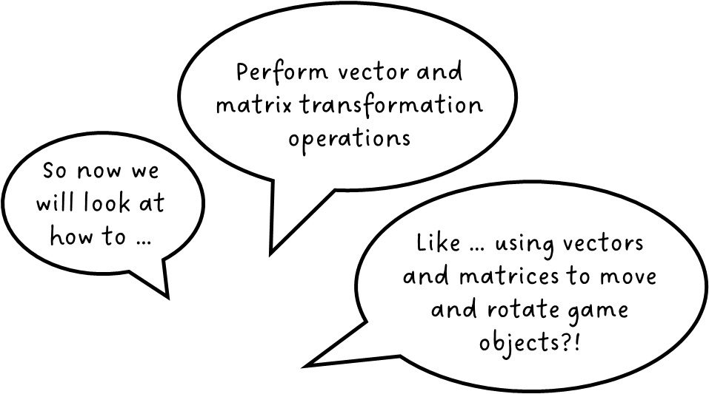


Cool!

Slide 3
At the end of this lecture, you should be able to:
Describe what is an affine transformation
Perform translation using addition or multiplication
Perform scaling using multiplication
Perform rotation using multiplication
Perform matrix concatenations

Slide 4
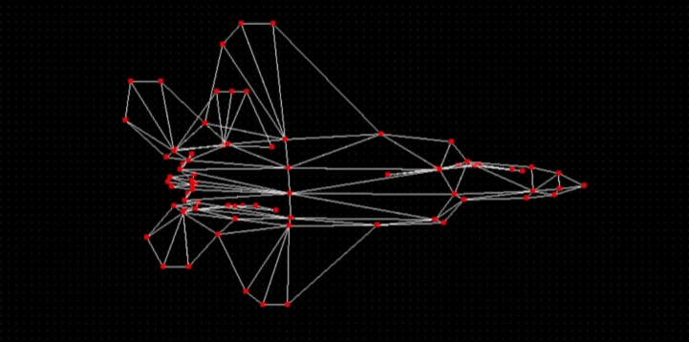
In games, objects can move
But how is this done?
Transformations
A transformation is a change from one physical state to another.
We’ll only explore 2D transformations for now
https://www.youtube.com/watch?v=Do_vEjd6gF0

Slide 5

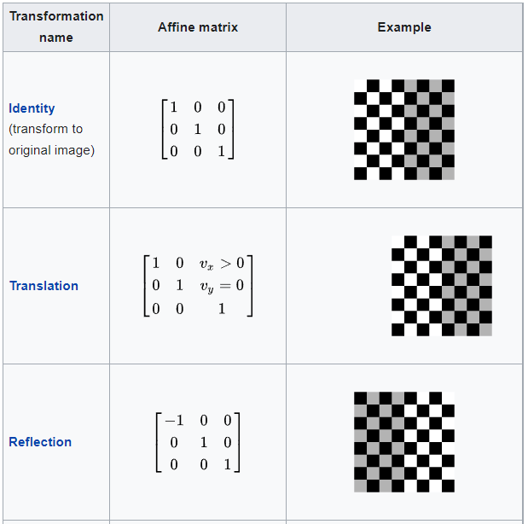
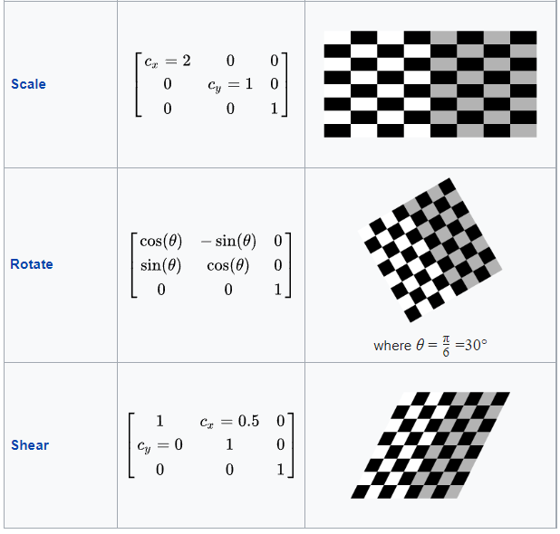
Affine transformations
Points which lie on a line continue to be collinear after the transformation
https://en.wikipedia.org/wiki/Affine_transformation

Slide 6


Affine transformations
Points which lie on a line continue to be collinear after the transformation

Slide 7
Affine transformations
Ratios of distances are preserved.

Slide 8
Affine transformations
Ratios of distances are preserved.
Basically, the essential shape of an object is preserved after transformation.

Slide 9


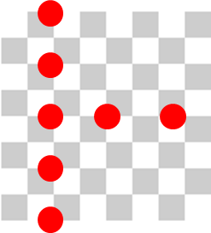
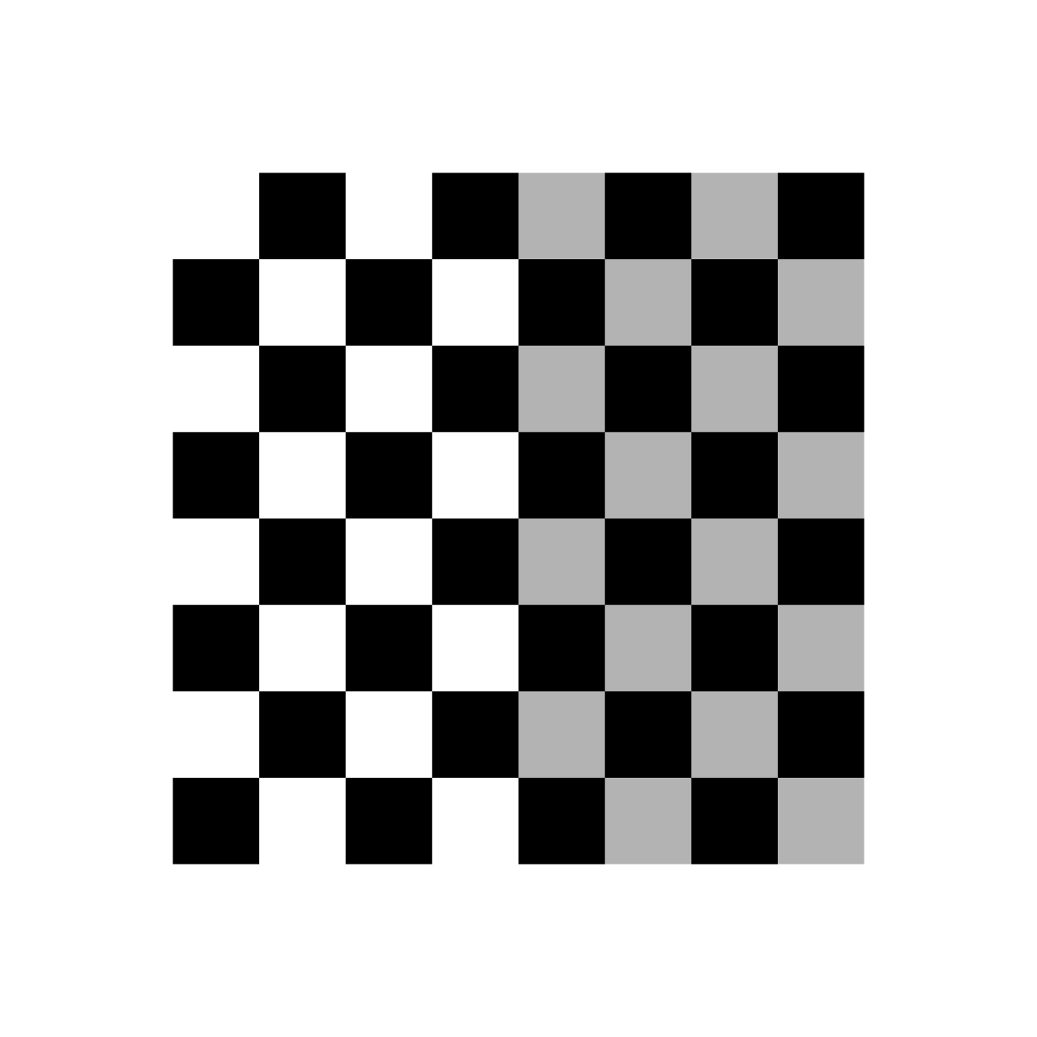
Affine transformations
Ratios of distances are preserved.
1.55
1.25
3.65
3.0
1.25/3.0 = 0.42
1.55/3.65 = 0.42
https://en.wikipedia.org/wiki/Affine_transformation

Slide 10

Affine transformations
Parallel lines remain parallel
https://en.wikipedia.org/wiki/Affine_transformation

Slide 11
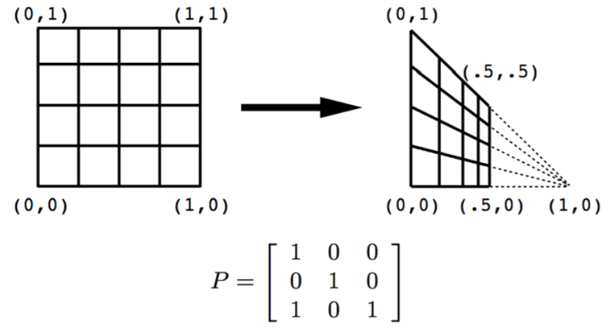
Non-affine transformations
not colinear
Ratios of distances are not preserved
A perspective transformation is non-affine (why?)
Do parallel lines remain parallel?
Parallelism is not preserved

Slide 12
Rotation
via matrix multiplication

Slide 13
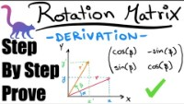
Let’s watch this first – a very clear (and brief!) derivation of the 2D rotation matrix.

Slide 14
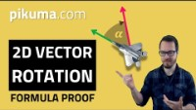
This is here for your reference.
You should watch this after class (37m)
A long video, but worth watching!
https://www.youtube.com/watch?v=tEUpWgy-Tuo

Slide 15
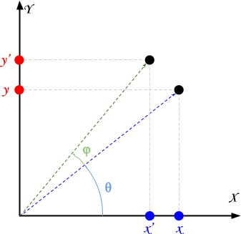
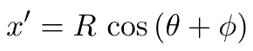
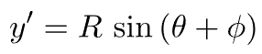


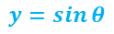

Rotation via matrix multiplication
Remember the unit circle, with radius = 1
This is 2D, so the rotation is about the z axis
Radius of 1
$$\cos{θ}$$
$$y=sin{θ}$$
$$\sin{θ}$$
$$x=cos{θ}$$
Phi
Theta
The distance from the origin is fixed
Positive angle means rotate counterclockwise
next slide
Radius of any value
http://www.alanzucconi.com/2016/02/03/2d-rotations/

Slide 16
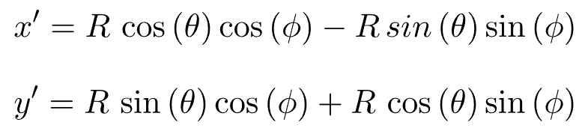
Rotation via matrix multiplication
Trigonometric identities

Slide 17
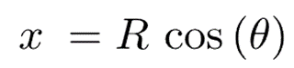
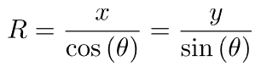
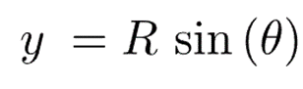
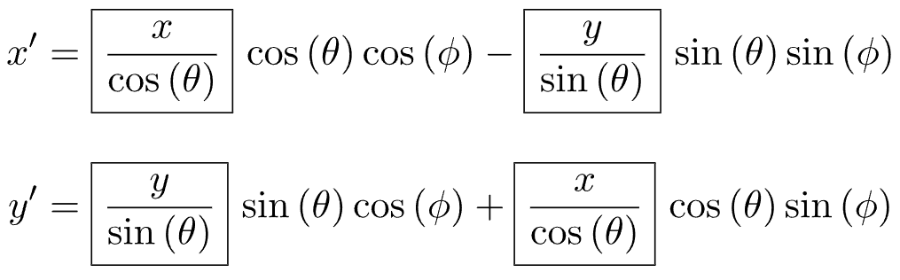
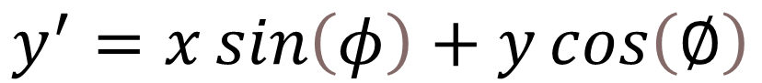
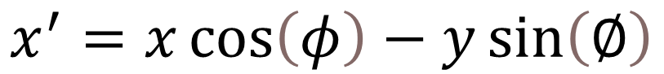
Rotation via matrix multiplication
1
2
3
$$x^{′}=x\cos\left(φ\right)−y\sin\left(∅\right)$$
4
$$y^{′}=x\sin\left(φ\right)+y\cos\left(∅\right)$$

Slide 18

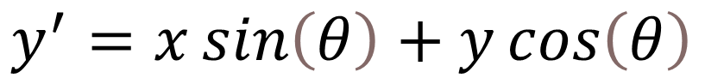

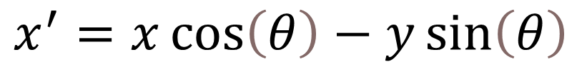
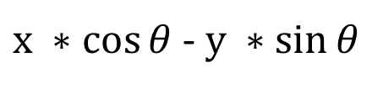
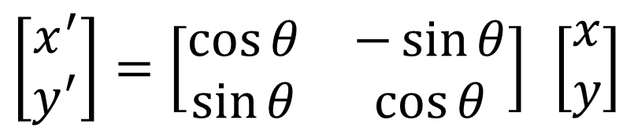
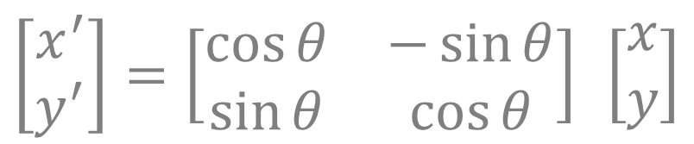
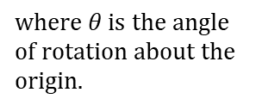
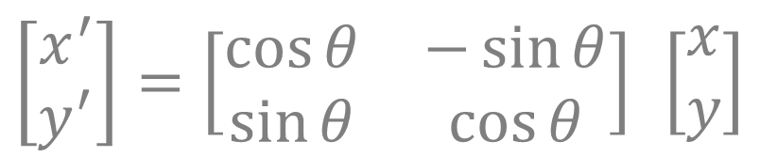
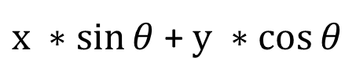
Rotation via matrix multiplication
So, in general …
$$x^{′}=x\cos\left(θ\right)−y\sin\left(θ\right)$$
$$y^{′}=x\sin\left(θ\right)+y\cos\left(θ\right)$$
Matrix form
$$\left[\begin{matrix}x^{′} \\ y^{′}\end{matrix}\right]=\left[\begin{matrix}\cos{θ} & −\sin{θ} \\ \sin{θ} & \cos{θ}\end{matrix}\right] \left[\begin{matrix}x \\ y\end{matrix}\right]$$
$$\text{where} θ \text{is} \text{the} \text{angle} \text{of} \text{rotation} \text{about} \text{the} \text{origin}\text{.}$$
$$x^{′}$$
$$\left[\begin{matrix}x^{′} \\ y^{′}\end{matrix}\right]=\left[\begin{matrix}\cos{θ} & −\sin{θ} \\ \sin{θ} & \cos{θ}\end{matrix}\right] \left[\begin{matrix}x \\ y\end{matrix}\right]$$
$x ∗cos{θ}$ - $y ∗sin{θ}$
$$\left[\begin{matrix}x^{′} \\ y^{′}\end{matrix}\right]=\left[\begin{matrix}\cos{θ} & −\sin{θ} \\ \sin{θ} & \cos{θ}\end{matrix}\right] \left[\begin{matrix}x \\ y\end{matrix}\right]$$
$x ∗sin{θ}$ + $y ∗cos{θ}$
$$y^{′}$$

Slide 19
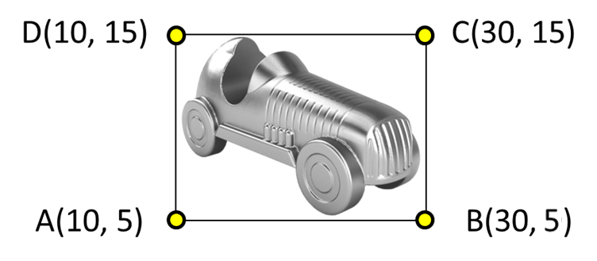
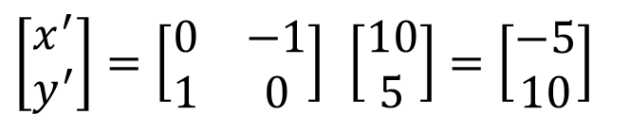
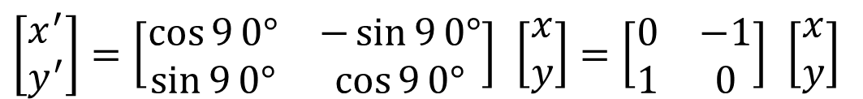
Rotation via matrix multiplication
Example: rotate the car sprite 90º counter-clockwise
Set up the matrix
$$\left[\begin{matrix}x^{′} \\ y^{′}\end{matrix}\right]=\left[\begin{matrix}\cos{9}0° & −\sin{9}0° \\ \sin{9}0° & \cos{9}0°\end{matrix}\right] \left[\begin{matrix}x \\ y\end{matrix}\right]=\left[\begin{matrix}0 & −1 \\ 1 & 0\end{matrix}\right] \left[\begin{matrix}x \\ y\end{matrix}\right]$$
$$\left[\begin{matrix}x^{′} \\ y^{′}\end{matrix}\right]=\left[\begin{matrix}0 & −1 \\ 1 & 0\end{matrix}\right] \left[\begin{matrix}10 \\ 5\end{matrix}\right]=\left[\begin{matrix}−5 \\ 10\end{matrix}\right]$$
Plug in A to find A’
A’ is (-5, 10)

Slide 20
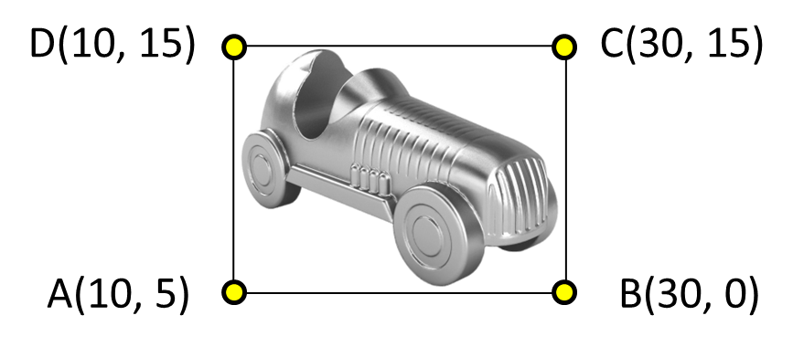
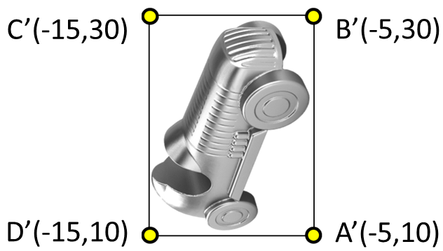
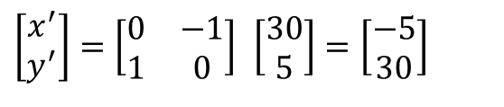
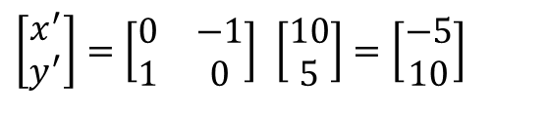
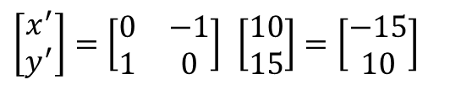
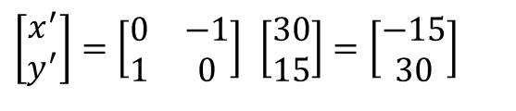
Rotation via matrix multiplication
Before
After
$$\left[\begin{matrix}x^{′} \\ y^{′}\end{matrix}\right]=\left[\begin{matrix}0 & −1 \\ 1 & 0\end{matrix}\right] \left[\begin{matrix}10 \\ 5\end{matrix}\right]=\left[\begin{matrix}−5 \\ 10\end{matrix}\right]$$
A’
$$\left[\begin{matrix}x^{′} \\ y^{′}\end{matrix}\right]=\left[\begin{matrix}0 & −1 \\ 1 & 0\end{matrix}\right] \left[\begin{matrix}30 \\ 5\end{matrix}\right]=\left[\begin{matrix}−5 \\ 30\end{matrix}\right]$$
B’
$$\left[\begin{matrix}x^{′} \\ y^{′}\end{matrix}\right]=\left[\begin{matrix}0 & −1 \\ 1 & 0\end{matrix}\right] \left[\begin{matrix}30 \\ 15\end{matrix}\right]=\left[\begin{matrix}−15 \\ 30\end{matrix}\right]$$
C’
$$\left[\begin{matrix}x^{′} \\ y^{′}\end{matrix}\right]=\left[\begin{matrix}0 & −1 \\ 1 & 0\end{matrix}\right] \left[\begin{matrix}10 \\ 15\end{matrix}\right]=\left[\begin{matrix}−15 \\ 10\end{matrix}\right]$$
D’
-20
-10
0
10
20
30

Slide 21
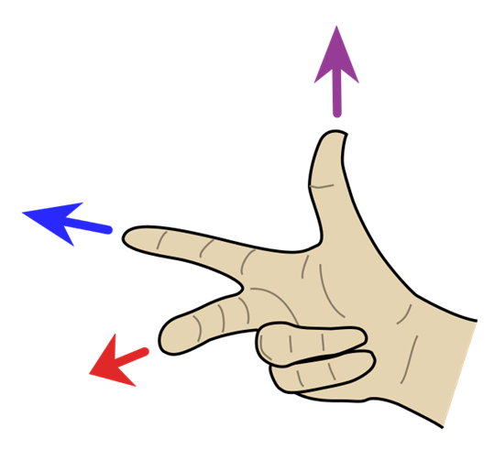
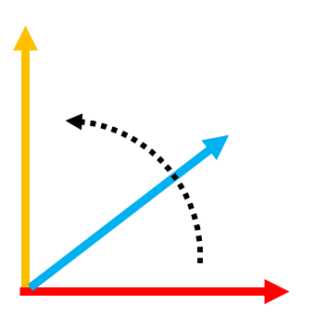
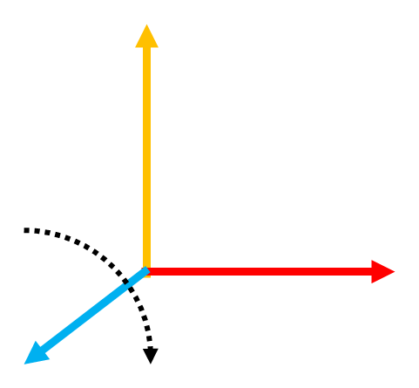
Rotation via matrix multiplication
Left vs right-handed
coordinate systems
For a left-handed coordinate system positive rotations are anti-clockwise
For a right-handed coordinate system positive rotations are clockwise

Slide 22
Rotation via matrix multiplication
An anti-clockwise rotation
Same 2D matrix and angle
| cos(90) -sin(90) |
| sin(90) cos(90) |
LHS
Unity uses a left-handed coordinate system (LHS)
In a more intensive games programming course, you would likely use the OpenGL graphics library.
A clockwise rotation
RHS
OpenGL is right-handed.

Slide 23
Scaling via matrix multiplication
In geometry, uniform scaling is a linear transformation that enlarges or diminishes objects.
-20
-10
0
10
20
30
We multiply each point’s x and y values by the scale factor for the x and y axes.
For uniform scaling, set S_{x} = S_{y}.

Slide 24
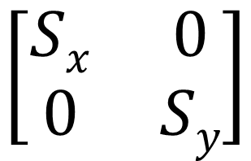
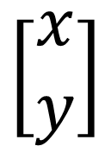
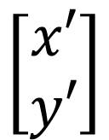
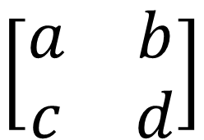
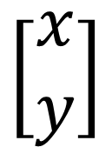
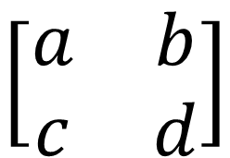
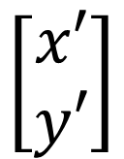
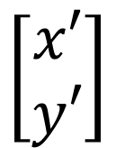
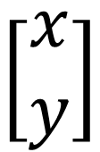
Scaling via matrix multiplication
Each point is a vector (with origin 0,0).
We can multiply a vector by a matrix to change the vector’s x, y values.
What is the matrix for 2D scaling?
$$\left[\begin{matrix}x′ \\ y′\end{matrix}\right]$$
$$\left[\begin{matrix}a & b \\ c & d\end{matrix}\right]$$
$$\left[\begin{matrix}x \\ y\end{matrix}\right]$$
$$\left[\begin{matrix}x′ \\ y′\end{matrix}\right]$$
$$\left[\begin{matrix}a & b \\ c & d\end{matrix}\right]$$
$$\left[\begin{matrix}x \\ y\end{matrix}\right]$$
=
=
x’ = a * x + b * y
y’ = c * x + d * y
S_{x}
0
0
S_{y}
Must be 0, as only x is scaled here
Must be 0, as only y is scaled here
$$\left[\begin{matrix}x′ \\ y′\end{matrix}\right]$$
$$\left[\begin{matrix}Sx & 0 \\ 0 & Sy\end{matrix}\right]$$
$$\left[\begin{matrix}x \\ y\end{matrix}\right]$$
=

Slide 25
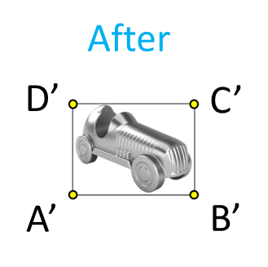




Scaling via matrix multiplication
Before

Slide 26

Translation via vector addition
Suppose we have an object at P(3, 4).
You want to move it 3 units to the right and 1 unit up.
It’s new location is P’ = (3+3, 4+1) = (6, 5)
Matrix form:
Remember, a vector is just a special form of matrix

Slide 27
Translation via vector addition
Translation by addition
2D:
3D:
Where:
dx is the change in x
dy is the change in y
dz the change in z

Slide 28


Translation via vector addition
$$\left[\begin{matrix}x^{′} \\ y^{′}\end{matrix}\right]=\left[\begin{matrix}x \\ y\end{matrix}\right]+\left[\begin{matrix}dx \\ dy\end{matrix}\right]$$
Position (x, y, z)
Movement with velocity V can be implemented as a change in position every timestep
Change (dx, dy, dz)
New Position (x + dx, y + dy, z + dz)
after timestep
Velocity V (vx, vy, vz)
Origin

Slide 29
Translation via vector addition
A car sprite has 4 corner vertices.
Set up a vector that will move the car 50 units to the right and 80 units down, then use it to move the car.
50 units right
vertex A
80 units down

Slide 30
Translation via vector addition
Repeat for the other vertices
We get B’(80,-80), C’(80,-65) and D’(60,-65)

Slide 31
Translation via vector addition
translation
D’(60,-65)
C’(80,-65)
A’(60,-75)
B’(80,-80)

Slide 32


In-place transformations
The scaling centre is always the origin.
If we scale an object not centred at the origin, it moves away!
If we rotate an object not centred at the origin it will also be translated!

Slide 33
In-place transformations
How can we rotate or scale in-place?
A sequence of transformations
Translate to origin
Rotate at origin
Translate back
Translate to origin
Scale at origin
Translate back

Slide 34

Transformations at any point
How can we rotate or scale around any point?
P_{c}(3,2)
P_{t}(1,1)
θ
(transate by -1, -1)
Translate P_{t} to the origin
Rotate P_{c} around the origin by θ
Translate back by (1, 1)
Translate P_{c} by the same
θ
Follow the same steps for scaling
P_{c} has been rotated around P_{t} by θ

Slide 35






In a game, a character can perform transformations on objects using matrices.
Consider the following scenario:
A character has two objects, A and B, with coordinates A(3, 4) and B(-3, 4).
B(-3, 4)
A(3, 4)
θ
What is the rotation matrix, denoted as R(θ), required to align object A's position to object B's, when rotating about the origin?
1) Find θ
2) Find the rotation matrix, R(θ)
cos(θ) = (A.B) / (|A||B|)
$$\left[\begin{matrix}x^{′} \\ y^{′}\end{matrix}\right]=\left[\begin{matrix}\cos{θ} & −\sin{θ} \\ \sin{θ} & \cos{θ}\end{matrix}\right] \left[\begin{matrix}x \\ y\end{matrix}\right]$$
A.B = (3 * -3) + 4 * 4) = 7
|A| = sqrt(3^2 + 4^2) = 5
|B| = sqrt(-3^2 + 4^2) = 5
$$\left[\begin{matrix}\cos{1.287} & −\sin{1.287} \\ \sin{1.287} & \cos{1.287}\end{matrix}\right]$$
θ = arccos(7 / (5 * 5))
θ = 1.287 radians (73.74 degrees)
Online matrix multiplication!
https://openomnia.com/matrix-multiplication

Slide 36










Let’s check …
A(3, 4)
B(-3, 4)
$$\left[\begin{matrix}\cos{1.287} & −\sin{1.287} \\ \sin{1.287} & \cos{1.287}\end{matrix}\right]$$
$$\left[\begin{aligned}3 \\ 4\end{aligned}\right]$$
θ
$$\left[\begin{matrix}0.28 & −0.96 \\ 0.96 & 0.28\end{matrix}\right]$$
$$\left[\begin{aligned}3 \\ 4\end{aligned}\right]$$
$$\left[\begin{aligned}0.28 ∗ 3 + −0.96 ∗ 4 \\ 0.96 ∗ 3+ 0.28 ∗ 4 \end{aligned}\right]$$
$$\left[\begin{matrix}x^{′} \\ y^{′}\end{matrix}\right]=\left[\begin{matrix}\cos{θ} & −\sin{θ} \\ \sin{θ} & \cos{θ}\end{matrix}\right] \left[\begin{matrix}x \\ y\end{matrix}\right]$$
$$\left[\begin{aligned}0.84 + −3.84 \\ 2.88+1.12\end{aligned}\right]$$
$$\left[\begin{matrix}\cos{1.287} & −\sin{1.287} \\ \sin{1.287} & \cos{1.287}\end{matrix}\right]$$
$$\left[\begin{aligned}−3 \\ 4\end{aligned}\right]$$

Slide 37






If the character then wants to rotate object A around a point P(1, 2) by 45 degrees anti-clockwise, what would be the sequence of transformations required?
A(3, 4)
45º
P(1, 2)
A(2, 2)
P(0, 0)
1) Translate P by (-1, -2) to origin
(1, 2) + (-1, -2) = (0, 0)
Translate A by the same amount
A(1, 4.8)
(3, 4) + (-1, -2) = (2, 2)
A(2, 2)
2) Rotate A(2, 2) around the origin by 45º
45º
45º = 0.785 rads
$$\left[\begin{matrix}\cos{0.785} & −\sin{0.785} \\ \sin{0.785} & \cos{0.785}\end{matrix}\right]$$
$$\left[\begin{aligned}2 \\ 2\end{aligned}\right]$$
A(1, 4.8)
$$\left[\begin{aligned}0 \\ 2.8\end{aligned}\right]$$
A(3, 4)
45º
3) Translate P and A back by (1, 2)
$$\left[\begin{aligned}0 \\ 2.8\end{aligned}\right]$$
+
$$\left[\begin{aligned}1 \\ 2\end{aligned}\right]$$
$$\left[\begin{aligned}1 \\ 4.8\end{aligned}\right]$$

Slide 38

Matrix concatenation
Before looking at matrices, imagine you have the following calculation for n values of Y. n can be a very large number! How to simplify it?
Simplified, by combining all the separate multiplications into a single multiplication.
2 * 3 * 5 * 2 * 6 = 360
y₁
= x₁ * 2 * 3 * 5 * 2 * 6
y₁
= x₁ * 360
y₂
= x₂ * 2 * 3 * 5 * 2 * 6
y₂
= x₂ * 360
y₃
= x₃ * 2 * 3 * 5 * 2 * 6
y₃
= x₃ * 360
y_{n}
= x₄ * 2 * 3 * 5 * 2 * 6
y_{n}
= x₄ * 360
5 multiplications each
1 multiplication each
Can we do the same for matrix multiplication?

Slide 39




Matrix concatenation
When transformations are concatenated into a single matrix, this saves a lot of processing time!
Transformation of a point (or vector) from one space to another involves a simple matrix–vector multiplication operation.
Multiplying a point by a sequence of matrices can apply a sequence of transformations. Here, we apply scaling first,
And then rotation.
It is not necessary to store the intermediate points after each matrix–vector multiplication. It is possible and generally preferable to first multiply all of the matrices together to produce a single matrix representing the entire transformation sequence.
Multiply from first to last transformation in right-to-left order
(see next slide)
This matrix can then be used to transform points directly from the source to the destination coordinate space.
Forming products of transformation matrices is referred to as concatenation or composition of matrices.
https://www.brainvoyager.com/bv/doc/UsersGuide/CoordsAndTransforms/SpatialTransformationMatrices.html

Slide 40


In-place transformations
Matrix concatenation
Right-to-left multiplication
$$\left[\begin{matrix}x′ \\ y′\end{matrix}\right]$$
-TST
$$\left[\begin{matrix}x \\ y\end{matrix}\right]$$
=
column vector
This is just an example
scale
translate back
translate to origin
The "right-to-left" order of transformation matrices holds for column-matrix representations. In this representation, points such as A and B are represented as column vectors.
Problem?!
Rotation and scaling use matrix multiplication
But translation uses matrix addition
Must we separate translation?
Defeats the purpose!
https://www.brainvoyager.com/bv/doc/UsersGuide/CoordsAndTransforms/SpatialTransformationMatrices.html

Slide 41




Homogeneous coordinates
Rotation and scaling use matrix multiplication
But translation uses matrix addition
This extra dimension is called …
w
x + t_{x}
Could we apply translation as a matrix multiplication?!
y + t_{y}
Add an extra dimension
$$\left[\begin{matrix}1 & 0 & tx \\ 0 & 1 & ty \\ 0 & 0 & 1\end{matrix}\right]$$
$$\left[\begin{matrix}x \\ y \\ 1\end{matrix}\right]$$
x + 0 + t_{x}
$$\left[\begin{matrix}x+tx \\ y+ty \\ 1\end{matrix}\right]$$
0 + y + t_{y}
0 + 0 + 1
2x2 → 3x3
2x1 → 2x3
The same, but with an extra dimension

Slide 42


Homogeneous coordinates
It’s much more complex than this, involving how a 3D world is projected as a 2D image in computer graphics (they are also called projective coordinates).
homogeneous: of the same or a similar kind
They are called homogeneous coordinates because they treat points in Euclidean and projective space the same.
But as far as we are concerned, representing positions and vectors using homogeneous coordinates allows us to apply rotation, scaling, and translation as matrix multiplications.
This then allows us to concatenate multiple transformation matrices into a single matrix.

Slide 43
Homogeneous coordinates
A third coordinate is added to a 2D coordinate
A fourth coordinate is added to a 3D coordinate
2D
3D
So let’s look at those examples again …

Slide 44

Translation via vector multiplication
using homogenous coordinates
A car sprite has 4 corner vertices.
Set up a vector that will move the car 50 units to the right and 80 units down.
Translation values
vertex A

Slide 45

Translation via vector multiplication
using homogenous coordinates

Slide 46

Scaling via vector multiplication
using homogenous coordinates
D’
C’
A’
B’

Slide 47
Scaling via vector multiplication
using homogenous coordinates

Slide 48

Rotation via vector multiplication
using homogenous coordinates
You can work out the rest!

Slide 49
3D Rotation via vector multiplication
using homogenous coordinates
You will only be tested on 2D transformations!
Note the extra dimension!
Z axis rotation
z value not affected
x value not affected
X axis rotation
y value not affected
Y axis rotation

Slide 50





Rotation order affects final position
90º about x
90º about y
90º about y
90º about x

Slide 51
Examples of matrix concatenation #1
Rotation with respect to object’s center
Rotate triangle with vertices at A(50,40), B(100,40) and C(75,200) about its own center, which is (75,93).
C
C
A
B
C
C
A
B
A
B
A
B
Step 1
Step 2
Step 3
Step 2
Step 2
Step 1
Centre

Slide 52
Examples of matrix concatenation #1
Resulting combined matrix equation

Slide 53
Examples of matrix concatenation #2
Scaling with respect to object’s center
Scale any 3D object by half.
Will scale any 3D object in half with respect to its centre in just one step!
Note: this matrix just scales a single vertex. To scale an object this must be applied to every vertex.

Slide 54

Examples of matrix concatenation #3
Multiple rotations with respect to object’s center
Set up a matrix that will make a 3D object roll 30º, pitch 180º and yaw 90º using a single combo matrix.
Then apply this matrix to a triangle with vertices at A(200,0,-30), B(0,50,-150) and C(40,20,-100).
Y
Z
X
Rotate 90º about y
Rotate 180º about x
Rotate 30º about z
Yaw
Pitch
Roll
First to last, Right to left
https://gamedev.stackexchange.com/questions/137095/how-to-count-rotations-or-spins-when-using-addtorque

Slide 55
Examples of matrix concatenation #3
Multiple rotations with respect to object’s center
Apply matrix to each vertex
B’ is (150, -43.3, 25)
C’ is (100, -37.32, -24.64)
A’ is (30, -100, 173.2)
A
A’

Slide 56
Note: Unity mesh vertices are in LOCAL space
LOCAL space
WORLD space
(-2,2)
(2,2)
D
C
(3,6)
(7,6)
6
D
C
A
B
(-2,-2)
(2, -2)
2
A
B
(3,2)
(7,2)
LOCAL to WORLD space
3
7
(-2,2)
(3,6)
(2,2)
(7,6)
LOCAL to WORLD space
D
C
vertices[i] = transform.TransformPoint(vertices[i]);
// perform transformation
vertices[i] = transform.InverseTransformPoint(vertices[i]);
A
B
(-2,-2)
(3,2)
(2, -2)
(7,2)
WORLD to LOCAL space

Slide 57










Slide 58
Now do Part 2 of your Matrices worksheet!

